Slide 1
SAP PRESENTATION
    Data Flow from Materials Management to Finance

Slide 2
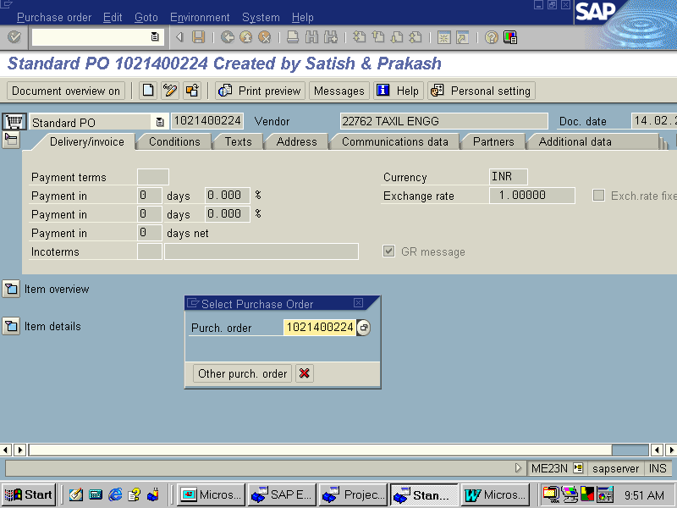
Domestic Purchases : Important Information which can be seen from Purchase Order . Transaction code ME23N -- The system will display “Display Purchase Order – Initial Screen”. Here we should enter the purchase order number.

Slide 3
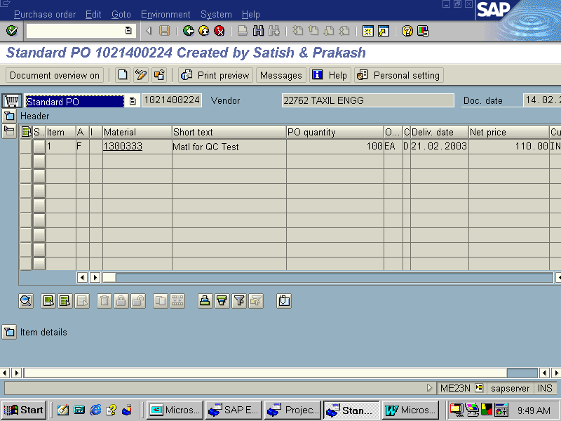
Press ENTER, The System displays “ Display Purchase Order – Item Overview” Screen indicating the line item details of the purchase order as below

Slide 4

In the above “ Display Purchase Order – Item Overview” screen, select the respective line item and click Item Details.
Then we get the “Display Purchase Order – Item 1021100048” screen as below indicating the full details of the product with respect to the P.O including the Tax Code.

Slide 5
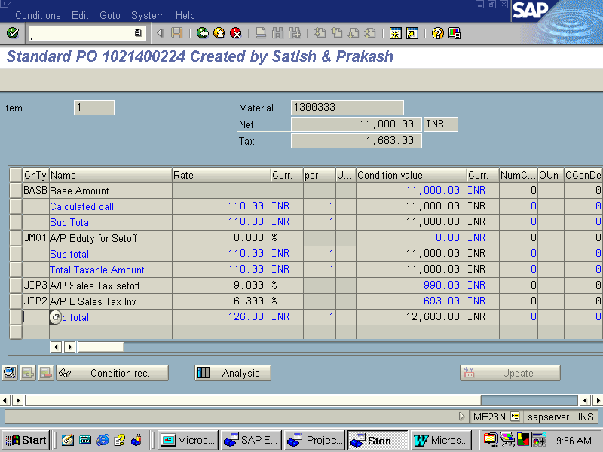
From above “Display Purchase Order – Item 1021400224” screen, select the respective line item and click Item - More Functions Taxes. Then the following screen with Tax details will appear where from all tax calculation details can be had. (ME23N)

Slide 6
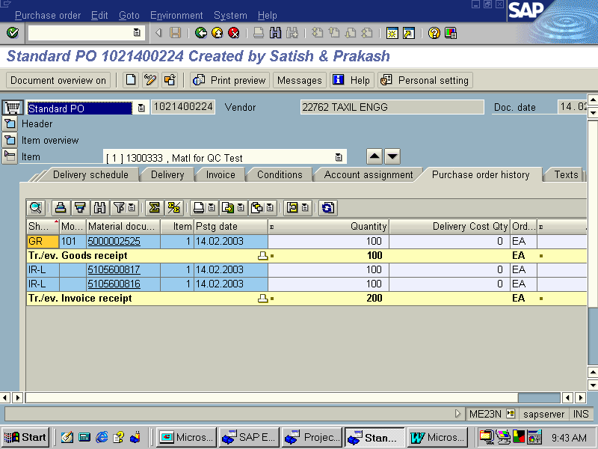
Go back to “Display Purchase Order – Item Overview” screen and press PO History Icon. We get “ Order History for Purchase Order” screen as below. Here we can get the status of PO regarding goods receipt, invoice verification, delivery costs (both planned & unplanned), Quantity and value etc. (ME23N)

Slide 7
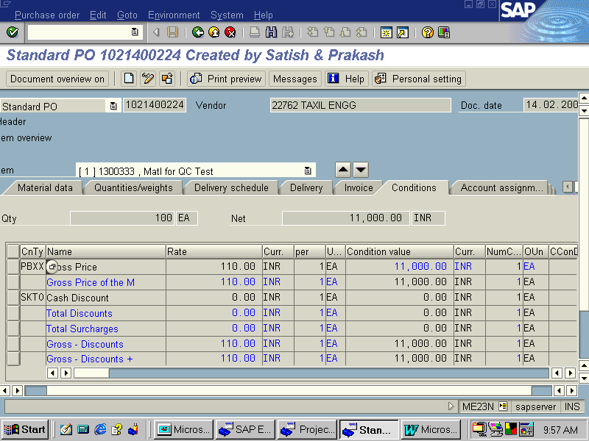
Go back to “Display Purchase Order – Item Overview” screen and press ITEM CONDITIONS Icon. We get “ Purchase Order Display: Item- Conditions ” screen as below giving details about Gross Price of material, Freight, Cash Discount etc.

Slide 8
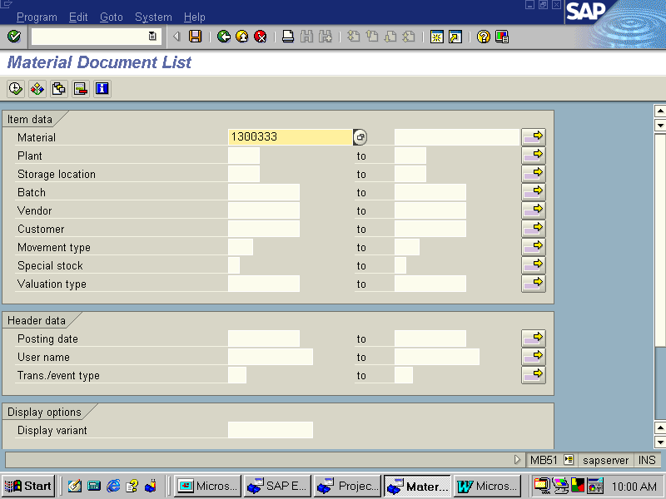
Important Points to be noted from Material Document
Transaction Code MB03. System will display“Display Material Document – Initial Screen” wherein you should enter the material document number and the year. The screen appears as under. (MB03 - MB51)

Slide 9
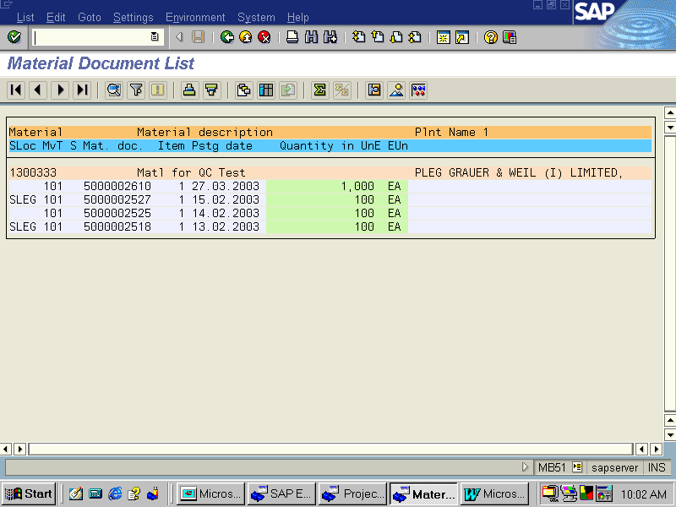
Press ENTER. We get “ Display Material Document 1 : Overview” screen as below (MB03)

Slide 10
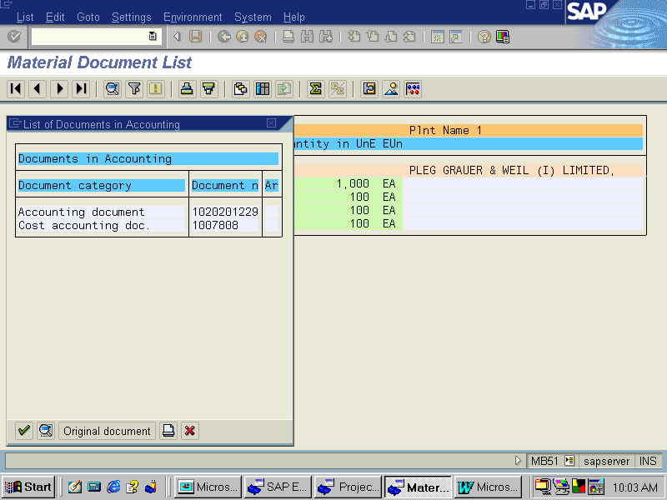
In the above screen, press “ACCOUNTING DOCS” Button. We get the “Document Overview” screen showing the entries as under (FB03)

Slide 11
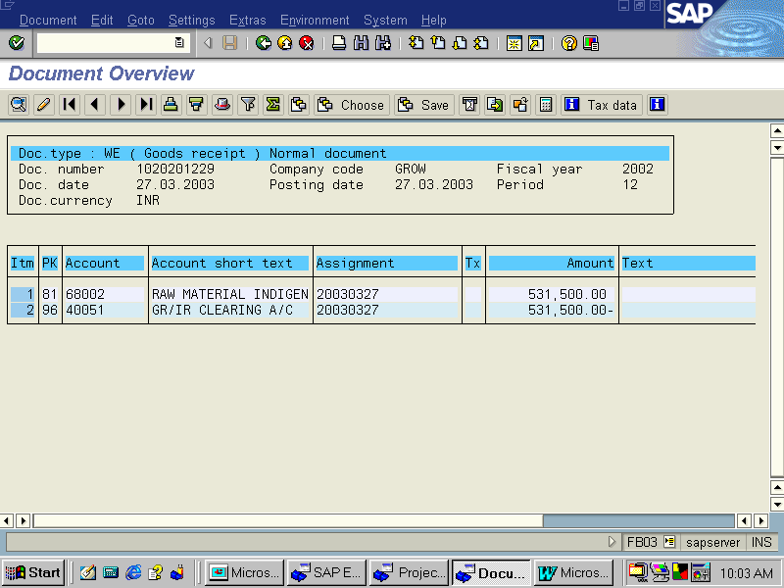
Important points to be noted we can get to see GR /IR and Raw Material accounts that has been effected as seen below.

